Slide 1
Chapter 10
Error Detection
10.

Slide 2
10-4 CYCLIC CODES
Cyclic codes are special linear block codes with one extra property. In a cyclic code, if a codeword is cyclically shifted (rotated), the result is another codeword.
Topics discussed in this section:
Cyclic Redundancy Check
Hardware Implementation
Polynomials
Cyclic Code Analysis
Advantages of Cyclic Codes
Other Cyclic Codes
10.

Slide 3

Figure 10.14 CRC encoder and decoder
10.

Slide 4

Figure 10.15 Division in CRC encoder
10.

Slide 5

Figure 10.16 Division in the CRC decoder for two cases
10.

Slide 6

Figure 10.17 Hardwired design of the divisor in CRC
10.

Slide 7
Using Polynomials
We can use a polynomial to represent a binary word.
Each bit from right to left is mapped onto a power term.
The rightmost bit represents the “0” power term. The bit next to it the “1” power term, etc.
If the bit is of value zero, the power term is deleted from the expression.

Slide 8

Figure 10.21 A polynomial to represent a binary word
10.

Slide 9

Figure 10.22 CRC division using polynomials
10.

Slide 10

Note
The divisor in a cyclic code is normally called the generator polynomial
or simply the generator.
10.

Slide 11
Note
In a cyclic code,
If s(x) ≠ 0, one or more bits is corrupted.
If s(x) = 0, either
a. No bit is corrupted. or
b. Some bits are corrupted, but the
decoder failed to detect them.
10.

Slide 12
Note
In a cyclic code, those e(x) errors that are divisible by g(x) are not caught.
Received codeword (c(x) + e(x))/g(x) =
c(x)/g(x) + e(x)/gx
The first part is by definition divisible the second part will determine the error. If “0” conclusion -> no error occurred. Note: that could mean that an error went undetected.
10.

Slide 13
Note
If the generator has more than one term and the coefficient of x⁰ is 1,
all single errors can be caught.
10.

Slide 14
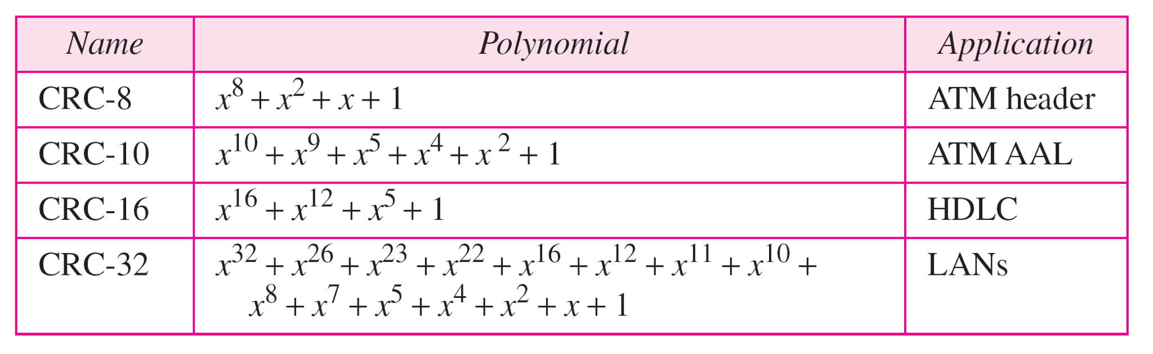
Table 10.7 Standard polynomials
10.

Slide 15
10-5 CHECKSUM
The last error detection method we discuss here is called the checksum. The checksum is used in the Internet by several protocols although not at the data link layer. However, we briefly discuss it here to complete our discussion on error checking
Topics discussed in this section:
Idea
One’s Complement
Internet Checksum
10.

Slide 16
Example 10.18
Suppose our data is a list of five 4-bit numbers that we want to send to a destination. In addition to sending these numbers, we send the sum of the numbers. For example, if the set of numbers is (7, 11, 12, 0, 6), we send (7, 11, 12, 0, 6, 36), where 36 is the sum of the original numbers. The receiver adds the five numbers and compares the result with the sum. If the two are the same, the receiver assumes no error, accepts the five numbers, and discards the sum. Otherwise, there is an error somewhere and the data are not accepted.
10.

Slide 17
Example 10.19
We can make the job of the receiver easier if we send the negative (complement) of the sum, called the checksum. In this case, we send (7, 11, 12, 0, 6, −36). The receiver can add all the numbers received (including the checksum). If the result is 0, it assumes no error; otherwise, there is an error.
10.

Slide 18
Example 10.20
How can we represent the number 21 in one’s complement arithmetic using only four bits?
Solution
The number 21 in binary is 10101 (it needs five bits). We can wrap the leftmost bit and add it to the four rightmost bits. We have (0101 + 1) = 0110 or 6.
10.

Slide 19
Example 10.21
How can we represent the number −6 in one’s complement arithmetic using only four bits?
Solution
In one’s complement arithmetic, the negative or complement of a number is found by inverting all bits. Positive 6 is 0110; negative 6 is 1001. If we consider only unsigned numbers, this is 9. In other words, the complement of 6 is 9. Another way to find the complement of a number in one’s complement arithmetic is to subtract the number from 2^{n} − 1 (16 − 1 in this case).
10.

Slide 20
Example 10.22
Let us redo Exercise 10.19 using one’s complement arithmetic. Figure 10.24 shows the process at the sender and at the receiver. The sender initializes the checksum to 0 and adds all data items and the checksum (the checksum is considered as one data item and is shown in color). The result is 36. However, 36 cannot be expressed in 4 bits. The extra two bits are wrapped and added with the sum to create the wrapped sum value 6. In the figure, we have shown the details in binary. The sum is then complemented, resulting in the checksum value 9 (15 − 6 = 9). The sender now sends six data items to the receiver including the checksum 9.
10.

Slide 21
Example 10.22 (continued)
The receiver follows the same procedure as the sender. It adds all data items (including the checksum); the result is 45. The sum is wrapped and becomes 15. The wrapped sum is complemented and becomes 0. Since the value of the checksum is 0, this means that the data is not corrupted. The receiver drops the checksum and keeps the other data items. If the checksum is not zero, the entire packet is dropped.
10.

Slide 22

Figure 10.24 Example 10.22
10.

Slide 23
Note
Sender site:
1. The message is divided into 16-bit words.
2. The value of the checksum word is set to 0.
3. All words including the checksum are
added using one’s complement addition.
4. The sum is complemented and becomes the
checksum.
5. The checksum is sent with the data.
10.

Slide 24
Note
Receiver site:
1. The message (including checksum) is
divided into 16-bit words.
2. All words are added using one’s
complement addition.
3. The sum is complemented and becomes the
new checksum.
4. If the value of checksum is 0, the message
is accepted; otherwise, it is rejected.
10.

Slide 25
Example 10.23
Let us calculate the checksum for a text of 8 characters (“Forouzan”). The text needs to be divided into 2-byte (16-bit) words. We use ASCII (see Appendix A) to change each byte to a 2-digit hexadecimal number. For example, F is represented as 0x46 and o is represented as 0x6F. Figure 10.25 shows how the checksum is calculated at the sender and receiver sites. In part a of the figure, the value of partial sum for the first column is 0x36. We keep the rightmost digit (6) and insert the leftmost digit (3) as the carry in the second column. The process is repeated for each column. Note that if there is any corruption, the checksum recalculated by the receiver is not all 0s. We leave this an exercise.
10.

Slide 26

Figure 10.25 Example 10.23
10.

